Slide 1
Intro to Python
Mofassir ul Islam Arif
Student Assistant
Masters in Data Analytics

Slide 2
Overview
Motivation
Learning goals
Topics covered in each tutorial
Overview of tools
Installation and setup
Overview of Python basics
General Q&A

Slide 3
Motivation
Basics refresher for seasoned python users.
Gentle introduction for newcomers to this language.
Aimed at building the specific skills that have proved useful to the Data Analytics WiSe 2016 batch.
Save time for the initial learning curve and shift focus from learning a language from scratch to building the machine learning base.
We would have appreciated this in the beginning, a lot.

Slide 4
Learning goals
Ease beginners into python 3.6
Introduction to the tools that will be used extensively in Machine Learning lab

Slide 5
Topics covered
Session | Topics covered
1 | Learning objective General guidance Setup of environments Basic exercises Overview of tools Data structures List comprehension Good practices Homework #1
Session | Topics covered
2 | Intro to numpy, matplotlib and pandas See what can be done using these libraries Basic exercises Homework #2 Linear regression using normal equations

Slide 6
Tools of the trade

Slide 7
Numpy
NumPy is the fundamental package for scientific computing with Python. It contains among other things:
a powerful N-dimensional array object
sophisticated (broadcasting) functions
tools for integrating C/C++ and Fortran code
useful linear algebra, Fourier transform, and random number capabilities
Workhorse for our matrix operations

Slide 8
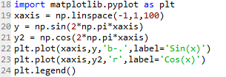
Numpy

Slide 9
Pandas
A set of labeled array data structures, the primary of which are Series and DataFrame
Index objects enabling both simple axis indexing and multi-level / hierarchical axis indexing
Input/Output tools:
Memory-efficient “sparse” versions of the standard data structures for storing data that is mostly missing or mostly constant (some fixed value)
More details in second tutorial

Slide 10
Installing python
Directly install python from python.org
Ubuntu:
$apt-get install python
$pip install (pip is a python package installation utility)
$ python (launch python shell)
$ python script.py (run python script)
Install Anaconda platform (most of the packages are pre-installed)
$ jupyter notebook (a interactive web based python shell)
$ ipython (launch python shell)

Slide 11
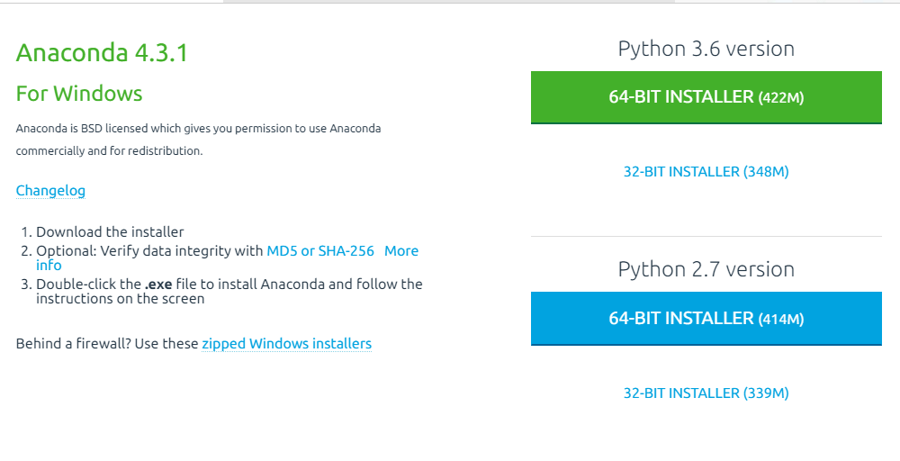
Setup and install
https://www.continuum.io/downloads

Slide 12
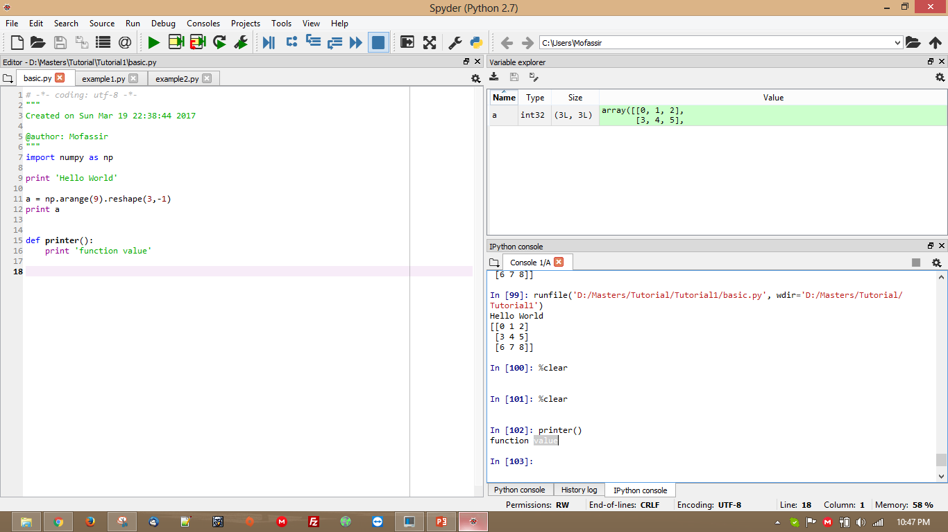
Hello World using Spyder

Slide 13
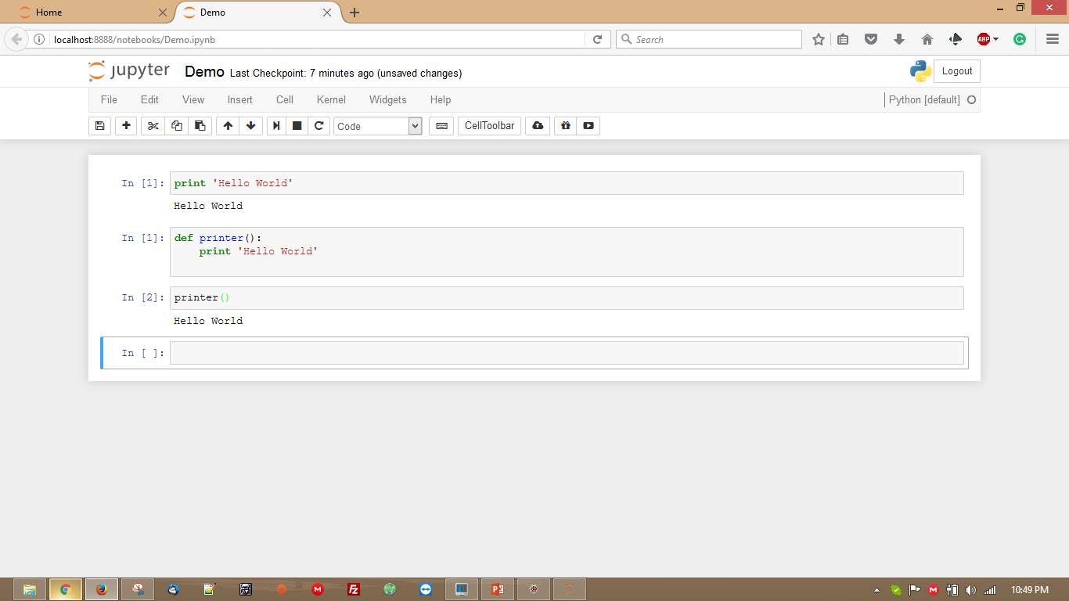
Hello World using Jypter

Slide 14
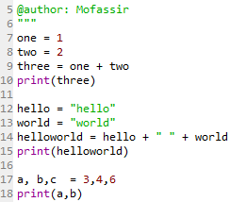
Python Basic
Variable declarations
Basic arithmetic operations are intuitive
Strings are declared in quotes.
Python lets you concatenate strings
Variables can also be declared

Slide 15
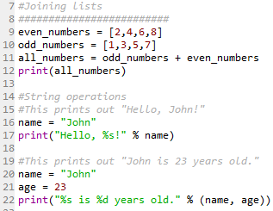
String Operations
Lists can also be joined as strings
Other methods include
Insert
Pop
Index
Append
Count
Sort
New_List.append(val)

Slide 16
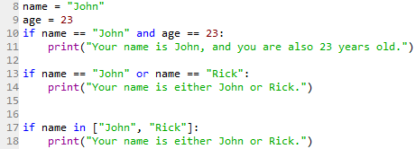
Conditionals
Intiuitive

Slide 17
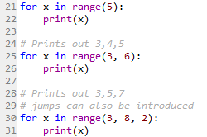
Loops
Loops are used to perform operations over variables
For loops do not need manual counters
Counters with steps are also included
While loops need counter to be maintained manually

Slide 18
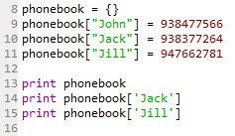
Dictionary
Key, value pair based data structure.
Addressing using the key
Iterating over the dictionaries.

Slide 19
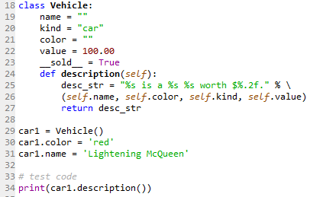
Classes
Classes are used similar to C++
No private variables, be careful.
__sold__ = True
Convention for naming private variables.

Slide 20
Modules
Importing modules lets you use existing libraries

Slide 21
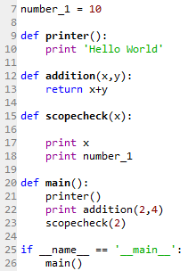
Functions
This is what your program should look like
Use functions for all the implementations (please)

Slide 22
Resources
https://docs.python.org
https://www.learnpython.org

